Slide 1

Myths of big partitions
Robert Stupp
Solution Architect @ DataStax, C*-Committer
@snazy
Notes:
POLL:
C* 2.x
C* 3.0.x
C* < 3.6
C* >= 3.6
Agenda
Why big partitions hurt before 3.6
What CASSANDRA-11206 changed
Things to consider

Slide 2
Issues with big partitions before 3.6
Slow reads
Compaction failures
Repair failures
java.lang.OutOfMemoryError → fail fast → node down (Lot of org.apache.cassandra.io.sstable.IndexInfo on heap)
Notes:
Big means many MB - couple 100s and more - like GB
Going to explain why this is an issue w/ C* < 3.6

Slide 3
SSTable Components
Bloom Filter
Determine whether an SSTable contains a partition → bloomFilterFpChance
Summary
Partition samples → minIndexInterval / maxIndexInterval
Primary Index
All partition keys + index samples → column_index_size_in_kb
Data
All the data
Notes:
Compression-Info – Digest – Statistics – TOC

Slide 4
Read from an SSTable
Bloom Filter
1. Check whether partition is in SSTable
Summary
2. Find “nearest” partition key 3. Return offset in primary index
Primary Index
4. Find partition
5. Find clustering key 6. Return offset in data file
Data
7. Find, read and return data
Notes:
Compression-Info – Digest – Statistics – TOC

Slide 5
Before CASSANDRA-11206

Slide 6
Evaluation of SSTable Components
Bloom Filter
Off-Heap, small → fine
Summary
Off-Heap, small-ish → fine
Primary Index
On-Heap, many small objects, nested structure
→ problematic
Data
For CQL since #8099 → fine
Notes:
Compression-Info – Digest – Statistics – TOC

Slide 7
Primary Index File Layout
”from” Summary
Partition Key
Partition Index Samples
Partition Key
Partition Index Samples
Partition Index Samples
Partition Key
Partition Index Samples
Partition Key
Partition Index Samples
Partition Index Samples
Partition Key
Partition Index Samples
Partition Key
Partition Index Samples
Partition Index Samples
Partition Key
Partition Index Samples
Partition Key
Partition Index Samples
Partition Index Samples
Partition Key
Partition Index Samples
Partition Key
Partition Index Samples
Partition Index Samples
Notes:
How a primary index file looks like
Read "comes" from Summary
Scan until requested Partition is found

Slide 8
Sampling the Primary Index
First Key
Last Key
First Key
Last Key
First Key
Last Key
First Key
Last Key
First Key
Last Key
First Key
Last Key
First Key
Last Key
Partition in Data file
column_index_size_in_kb (default: 64kB)
Partition Key
Offset in SSTable Data File

Slide 9
Binary search in the Primary Index
G ?
G ?
G ?
G greater than F
→ go right
G in bounds!
→ found!
G less than I
→ go left
A
B
D
F
G
H
I
K
M
P
T
V
W
X
Partition

Slide 10
How it looks on-heap
IndexedEntry
patitionKey*, offset, deletionInfo
IndexInfo
firstKey, lastKey, offset, width, deletionInfo
IndexInfo
firstKey, lastKey, offset, width, deletionInfo
IndexInfo
firstKey, lastKey, offset, width, deletionInfo
…
* = technically not in IndexedEntry
Notes:
Emphasize Java Objects

Slide 11
Primary Index Structure
IndexedEntry extends RowIndexEntry DeletionTime ArrayList IndexInfo ← per 64kB DeletionTime BufferClustering Kind ByteBuffer[] ByteBuffer byte[] … BufferClustering Kind ByteBuffer[] ByteBuffer byte[] …
# of Java objects:
IndexedEntry 4 IndexInfo (per 64kB) 8 + 4 * clust-key-components
(primitive fields omitted)

Slide 12
Primary Index - some numbers
Approximation on one 16 byte clustering-value:
Partition Size Index Size (heap) # of objects
1MB 3kB > 200 objects
4MB 11kB > 800 objects
64MB 180kB > 13,000 objects
512MB 1.4MB > 106,000 objects
2048MB 5.6MB > 424,000 objects
Disclaimer: numbers are examples and not representative
Notes:
Issues
Many objects
Promoted between Java heap generations
Evicted key cache entries usually in old gen
Huge GC pressure
Affects
Reads
Compaction
Repair
Flush (usually not an issue)

Slide 13
Reads, Compactions & Repairs
IndexedEntry including all IndexInfo read as Java object structure
IndexedEntry including all IndexInfo placed in key cache

Slide 14
Reads
SELECT foo, bar FROM big_partition_table WHERE ...
Reads IndexedEntry w/ all IndexInfo
2GB partition means: 32,768 IndexInfo, 424,000 objects
Binary search just needs: 15 IndexInfo (max), O(log n) ~200 objects
Disclaimer: numbers are examples and not representative
Notes:
IndexedEntry including all IndexInfo read as Java object structure
IndexedEntry including all IndexInfo placed in key cache
DONE for ALL kinds of reads

Slide 15
Writes – Flushes & Compactions
IndexedEntry constructed with all IndexInfo as Java object structure on heap first,
then serialized to disk

Slide 16
Compacting a 2GB partition
Key Cache
SSTable
SSTable
SSTable
SSTable
SSTable
Remove 106,000 objects
Remove 106,000 objects
Construct 424,000 objects
Remove 106,000 objects
106,000 objects
Remove 106,000 objects
106,000 objects
106,000 objects
Add 424,000 objects
106,000 objects
Disclaimer: numbers are examples and not representative

Slide 17
Reads of big partitions – on heap
Primary index data deserialized
Object structure added to key cache
Other entries evicted from key cache
Also applies to compaction & repair

Slide 18
Flushes with big partitions – on heap
Primary index data constructed
Object structure added to key cache (for compactions)
Also applies to compactions

Slide 19
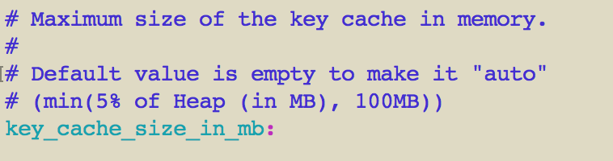
Trivia
How many 2GB partitions fit in the key cache?
100MB
2GB partition → 5.6MB
→ 100/6 = 16
Disclaimer: numbers are examples and not representative
Notes:
Global
- all sstables
- all tables
- all keyspaces

Slide 20
Issues w/ big partitions – TL;DR
Amount of Java objects
Additions and evictions to/from key cache

Slide 21


Slide 22
Necessities – TL;DR
Reduce amount of Java objects
Reduce GC pressure
No change in sstable format i.e. files need to be binary compatible

Slide 23
Approach
Omit (most) IndexInfo on heap
Read IndexInfo only when needed
Serialize primary index via byte buffer
Objects “never” promoted to Java old gen (hope so ;) )

Slide 24
Small heap (3GB) test
java.lang. OutOfMemoryError
Before #11206 – duration: 3h, lots of GC, exhausted heap
With #11206 – duration: 1h10, few GC, moderate heap usage
org.apache.cassandra.io.sstable.LargePartitionsTest
Notes:
Partition sizes: 16k, 1M, 4M, 8M … 512M, 1G, 2G, 4G, 8G with varying total data sizes

Slide 25
Results
Promising!
But: Performance regression w/ some workloads
Notes:
Nicely sized partitions (few MB)

Slide 26
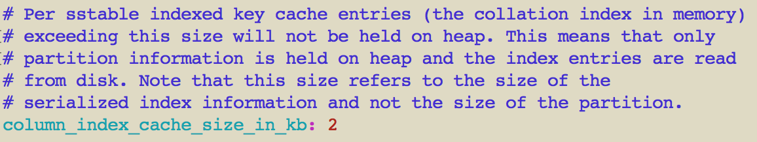
Better Approach
Keep IndexInfo objects for “nicely” sized partitions on-heap
Controlled via c.yaml

Slide 27
Doesn’t this mean more disk I/O?
“Hot” data already in buffer cache
No change for “cold” partitions

Slide 28
#11206 Benefits
Reduced heap usage
Reduced GC pressure
Improved read and write paths
Key cache can hold “more” entries
Moved the bad partition size “barrier”

Slide 29
#11206 Metrics
org.apache.cassandra.metrics: type=Index,scope=RowIndexEntry
name=IndexInfoCount Histogram - # of IndexInfo per IndexedEntry
name=IndexInfoGets Histogram - # of ”gets” against single IndexedEntry
name=IndexedEntrySize Histogram - serialized size of IndexedEntry
Notes:
Updated on reads

Slide 30
„After #11206, what‘s the recommended partition size?“
It still depends – sorry
IMO we moved the “barrier”
Test with your
data model
and workload

Slide 31
Bad usage of large partitions
CQL SELECT without clustering key
i.e. materialize a large partition in memory
Using the same partition key over a long time
i.e. access many sstables

Slide 32


Slide 33
#9754
Changes on-disk primary index format
Efficient on-disk representation
Optimized for OS page size
WIP !
Fix-Version: 4.x

Slide 34
Thank You!
Q & A
Come to the “experts stand”

